Slide 1
Fisheries Informatics Project
Deirdre Wall & Shawna Sanfey

Slide 2
Fisheries Informatics Project
MI based project aiming
to visualize existing fisheries data,
increase its usage/utility and
make it more easily accessible
Outputs:
Species Dashboard https://shiny.marine.ie/speciesdash/
Digital Stockbook https://shiny.marine.ie/stockbook/
IGFS data explorer https://shiny.marine.ie/igfs/
Cod tagging data portal https://shiny.marine.ie/tagging/
Team:
Project Manager
R developers (x2) statistical and biological/environmental background
SQL developer
MI lead by Colm Lordan and David Currie

Slide 3
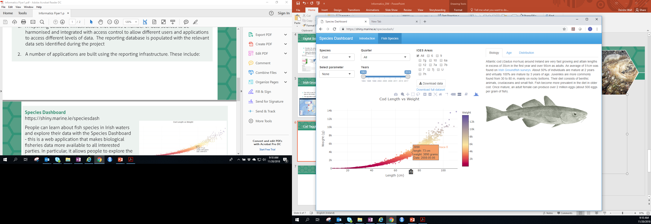
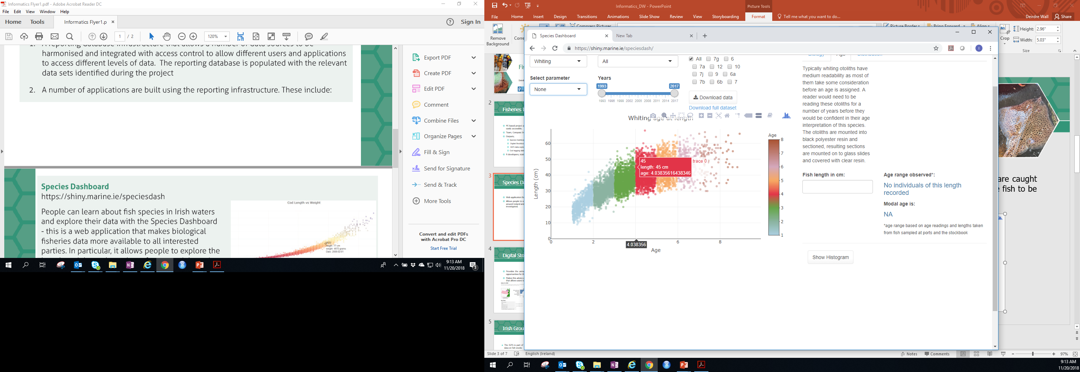
Species Dashboard
Web application that makes biological fisheries data more available
Allows people to explore the length, weight, and age data of commercial species that are caught around Ireland and allows the effects of factors such as year, sex, area, and gear on the fish to be investigated.

Slide 4
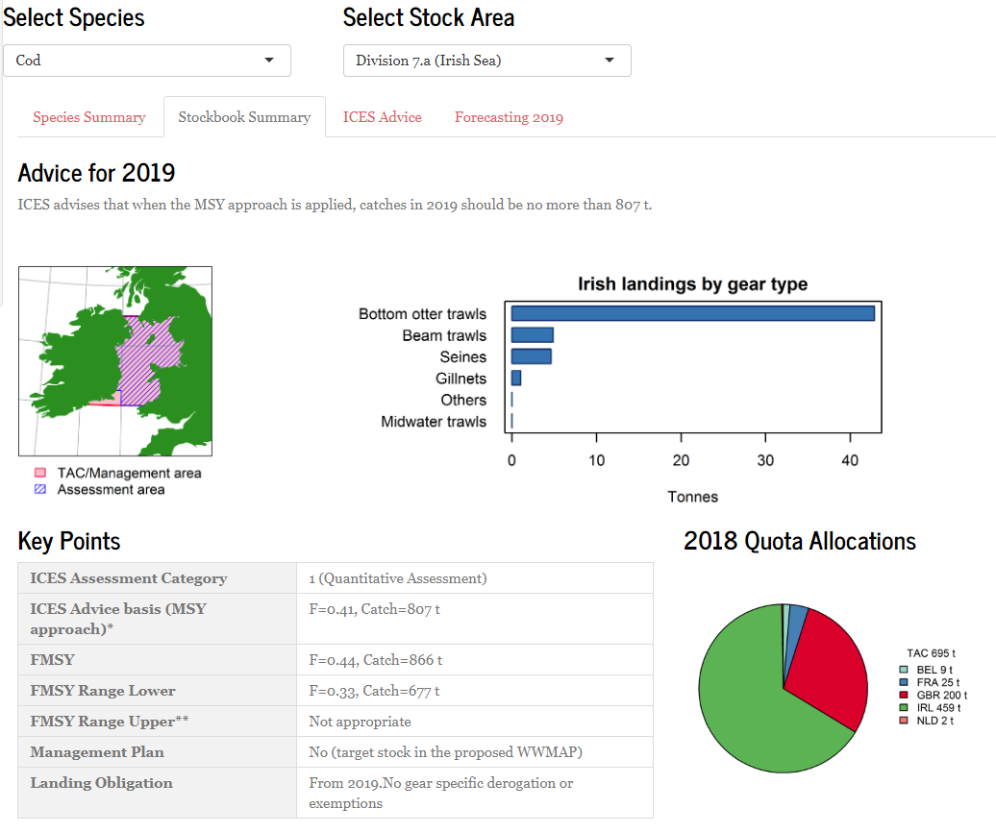
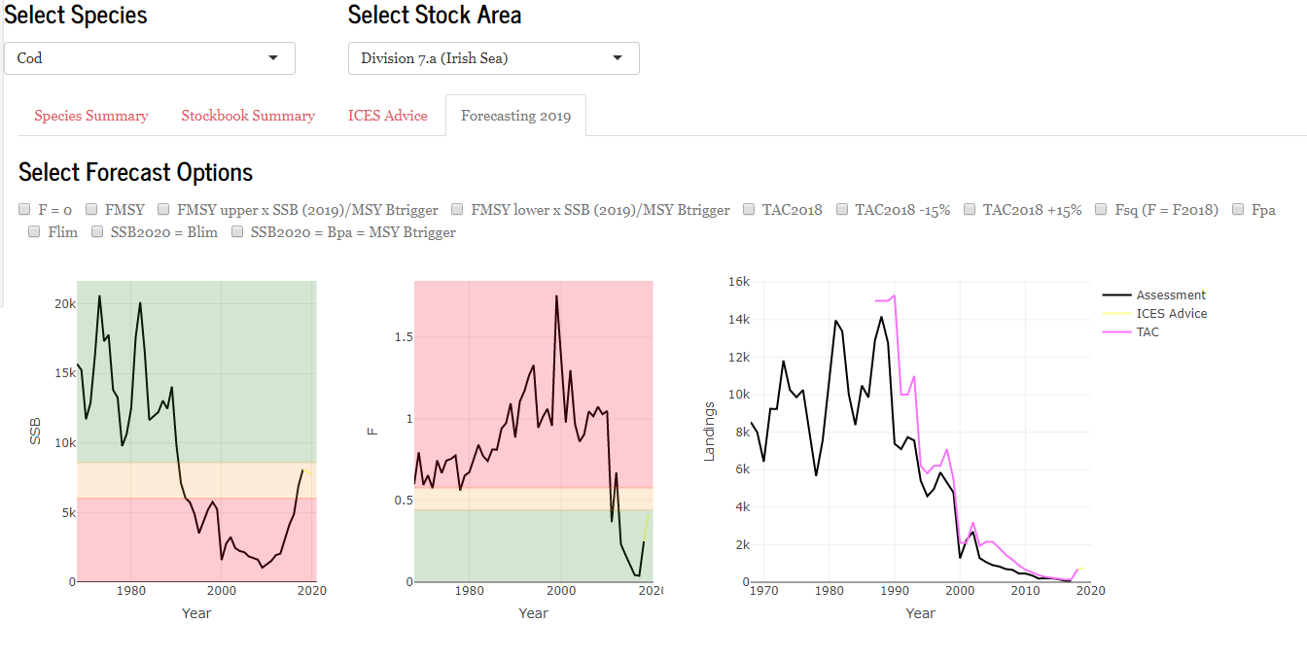
Digital Stockbook
Provides the annual review of fish stocks and the latest scientific advice that informs fishing opportunities for the following year.
Makes this advice available on-line in an interactive way – for example it includes a forecasting tool that allows users to see the projected impact of different fishing scenarios.

Slide 5
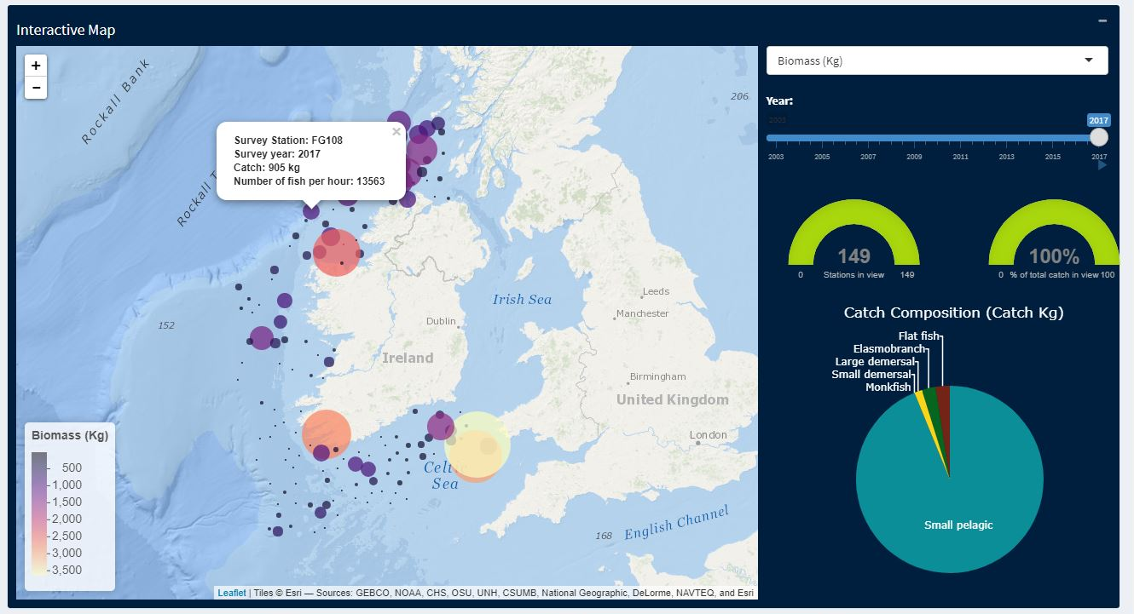
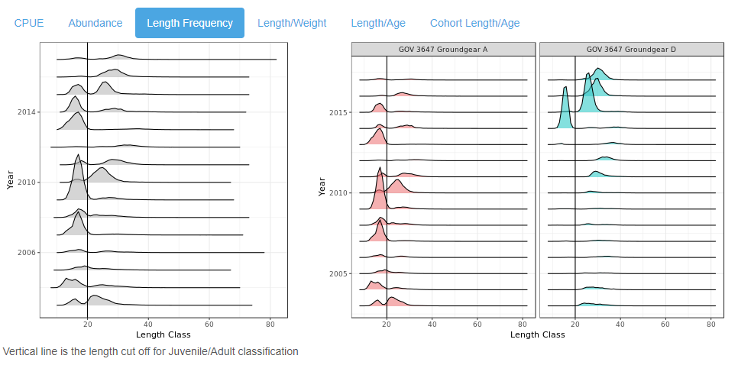
Irish Groundfish Survey Data Explorer
The IGFS is part of an internationally coordinated series of demersal trawl surveys that provides data on fish stocks
This app allows users to explore the results of the survey using a number of tools

Slide 6
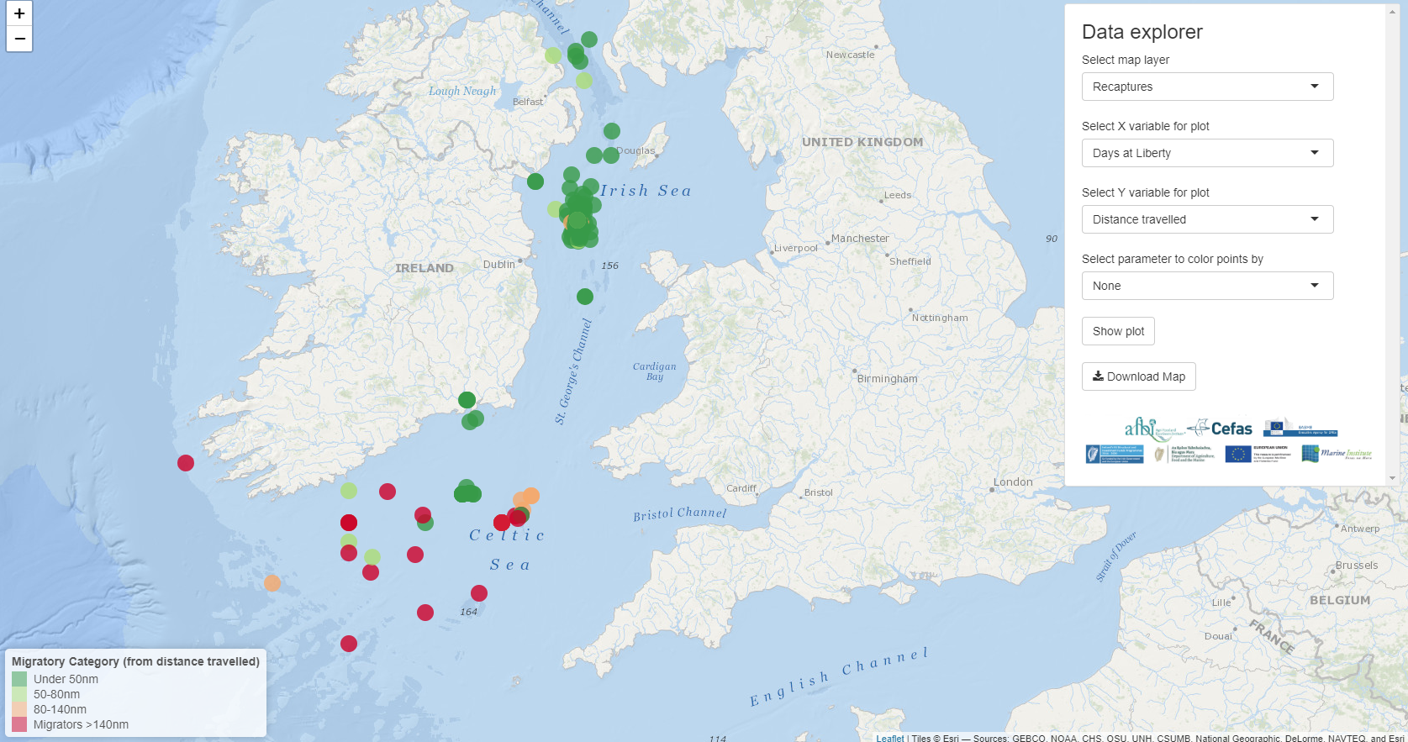
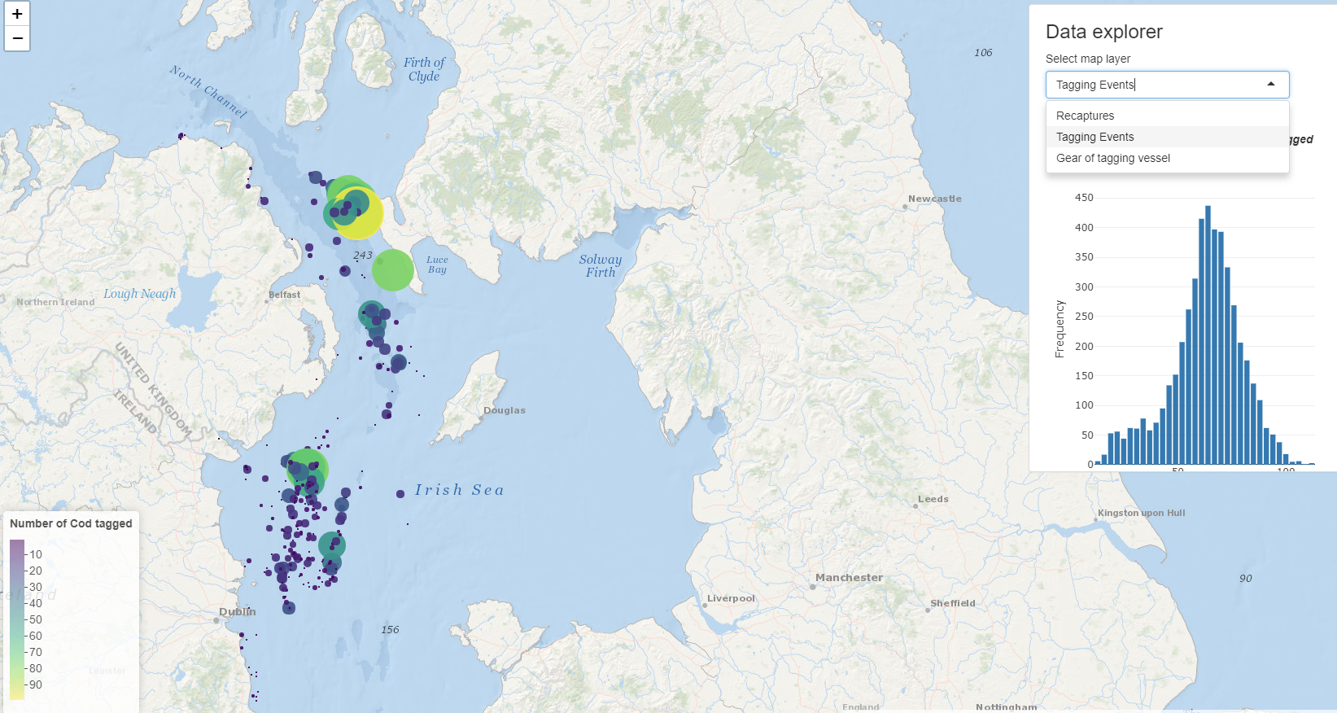
Cod Tagging
The Marine Institute, in partnership with AFBI and CEFAS, are conducting a cod tagging project in the Irish Sea
Graphical data-driven tool to look at the data collected
Recaptures, tagging events and gear of tagging vessel

Slide 7
New Section
Subheading for New Section

